Slide 1

HOUSING PROJECT
Submitted by
Sidda Lakshmi praneetha

Slide 2
CONTENTS
1.INTRODUCTION
1
2.DATA VISUALIZATION
2
3.RESULTS
3
4.CONCLUSION
4

Slide 3

INTRODUCTION
Houses are one of the necessary need of each and every person around the globe and therefore housing and real estate market is one of the markets which is one of the major contributors in the world’s economy. It is a very large market and there are various companies working in the domain. Data science comes as a very important tool to solve problems in the domain to help the companies increase their overall revenue, profits, improving their marketing strategies and focusing on changing trends in house sales and purchases. Predictive modelling, Market mix modelling, recommendation systems are some of the machine learning techniques used for achieving the business goals for housing companies. Our problem is related to one such housing company.

Slide 4

PROBLEMS

Slide 5

We are required to model the price of houses with the available independent variables. This model will then be used by the management to understand how exactly the prices vary with the variables. They can accordingly manipulate the strategy of the firm and concentrate on areas that will yield high returns. Further, the model will be a good way for the management to understand the pricing dynamics of a new market.

Slide 6
DATASET INFORMATION
Data contains 1460 entries each having 81 variables.
• Data contains Null values. You need to treat them using the domain knowledge and your own understanding.
• Extensive EDA has to be performed to gain relationships of important variable and price.
• Data contains numerical as well as categorical variable. You need to handle them accordingly.
• You have to build Machine Learning models, apply regularization and determine the optimal values of Hyper Parameters.
• You need to find important features which affect the price positively or negatively.
• Two datasets are being provided to you (test.csv, train.csv). You will train on train.csv dataset and predict on test.csv file.

Slide 7
CONCEPTS AND DOMAIN PROBLEM
A US-based housing company named Surprise Housing has decided to enter the Australian market. The company uses data analytics to purchase houses at a price below their actual values and flip them at a higher price. For the same purpose, the company has collected a data set from the sale of houses in Australia. The data is provided in the CSV file below.
The company is looking at prospective properties to buy houses to enter the market. You are required to build a model using Machine Learning in order to predict the actual value of the prospective properties and decide whether to invest in them or not. For this company wants to know:
• Which variables are important to predict the price of variable?
• How do these variables describe the price of the house?

Slide 8
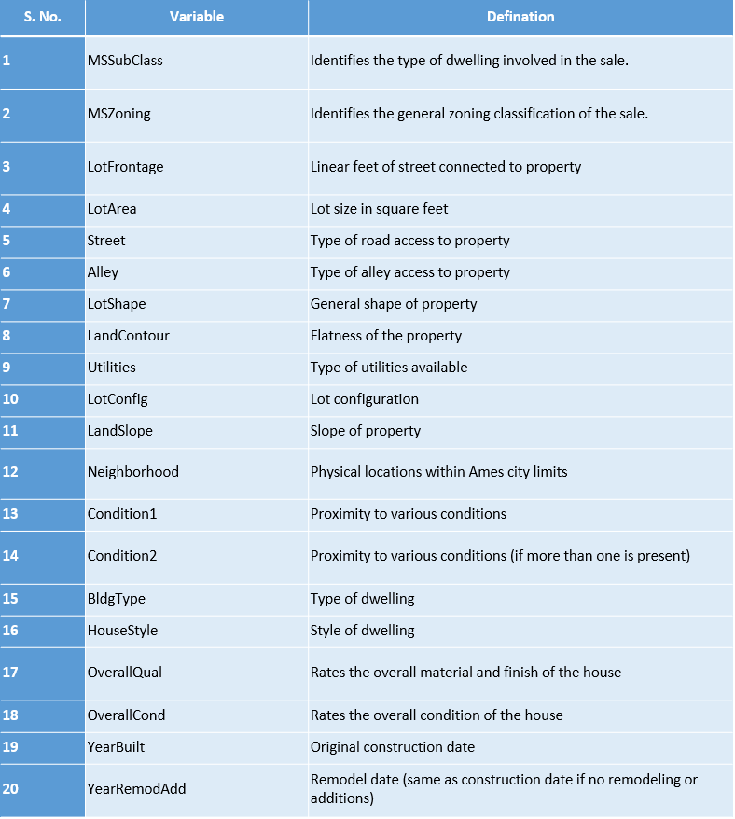
DATA DESCRIPTION

Slide 9
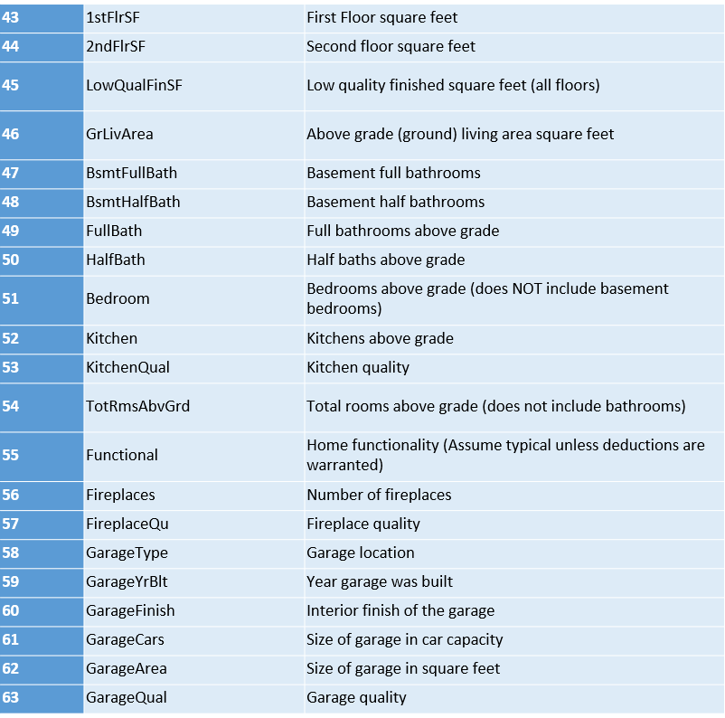
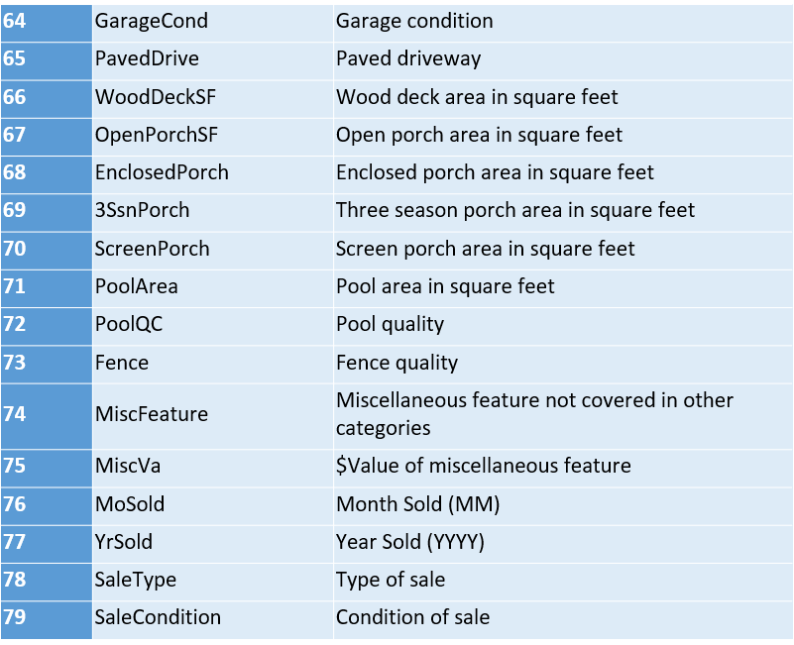

Slide 10

DATA VISUALIZATION

Slide 11
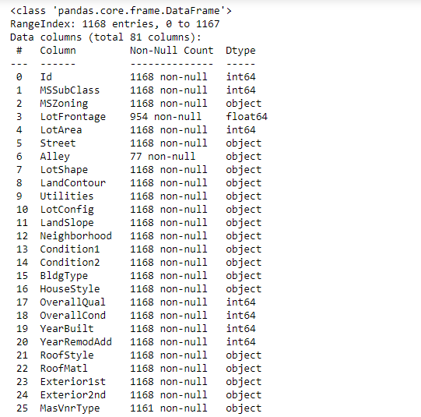
DATASET INFORMATION

Slide 12
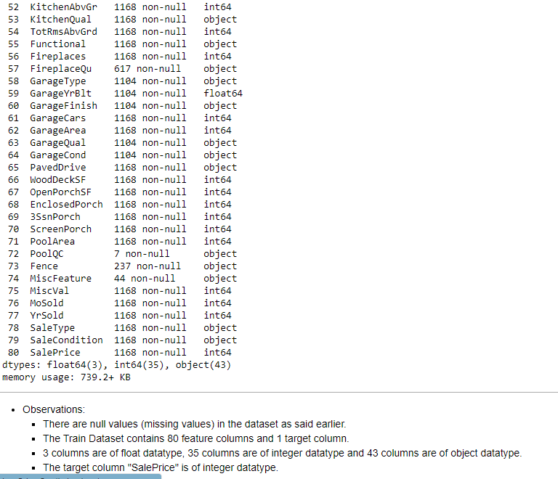

Slide 13
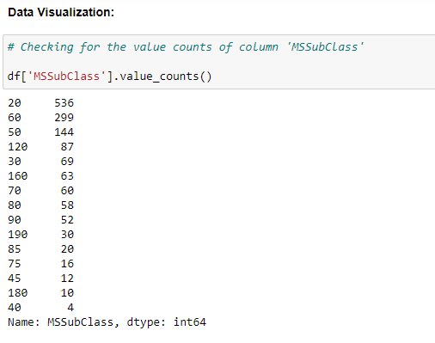
DATA VISUALIZATION

Slide 14
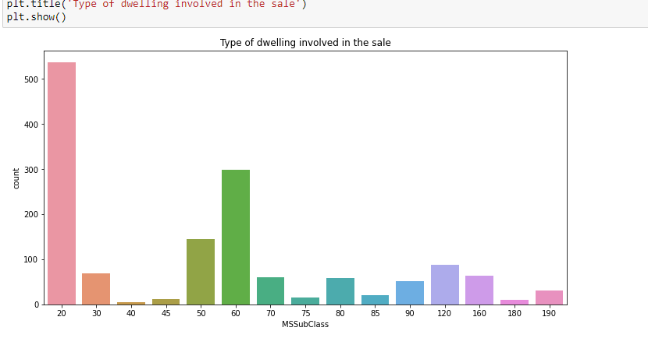

Slide 15
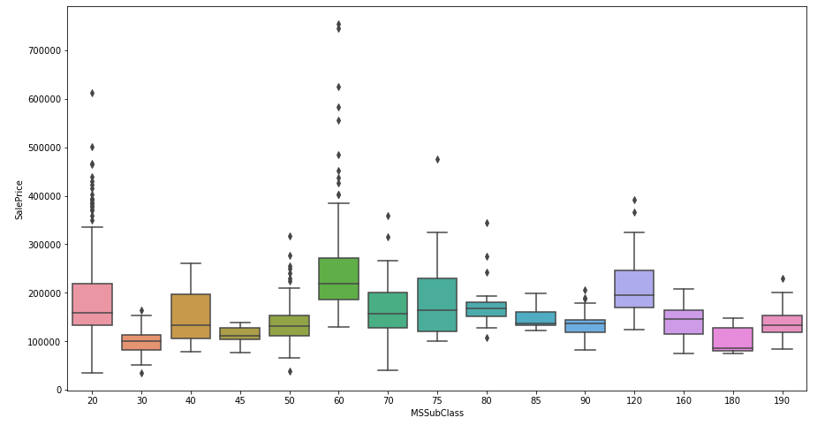

Slide 16
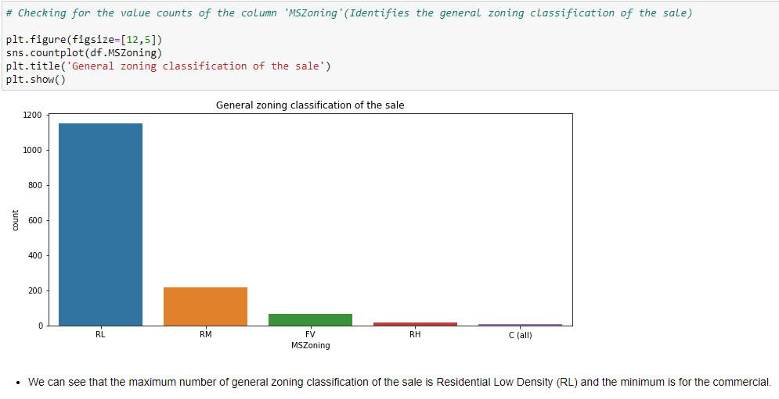

Slide 17
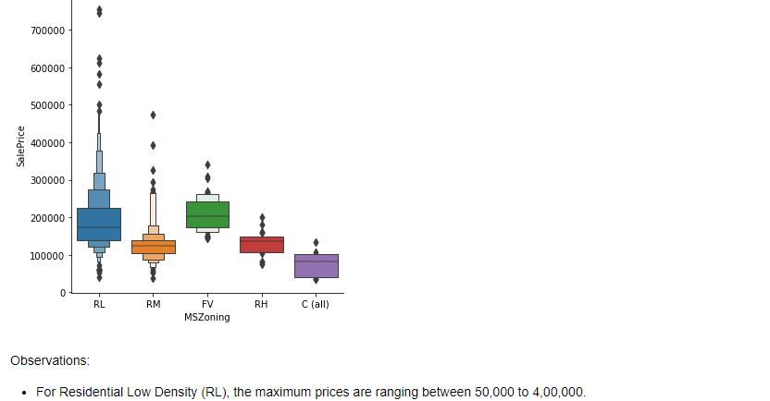

Slide 18
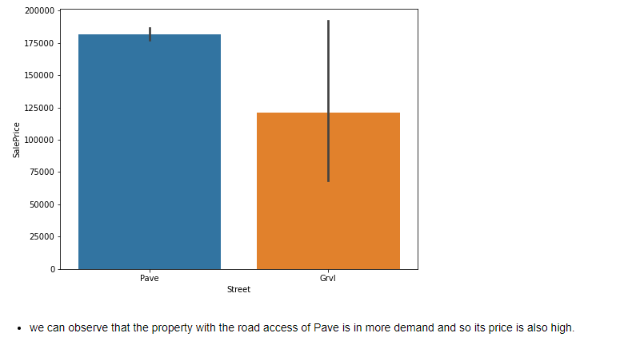

Slide 19
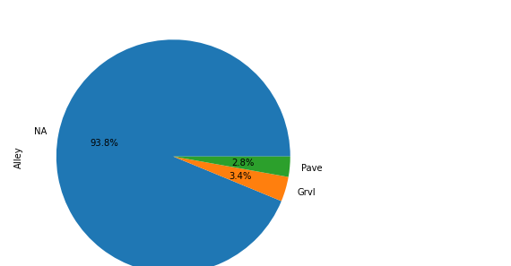

Slide 20
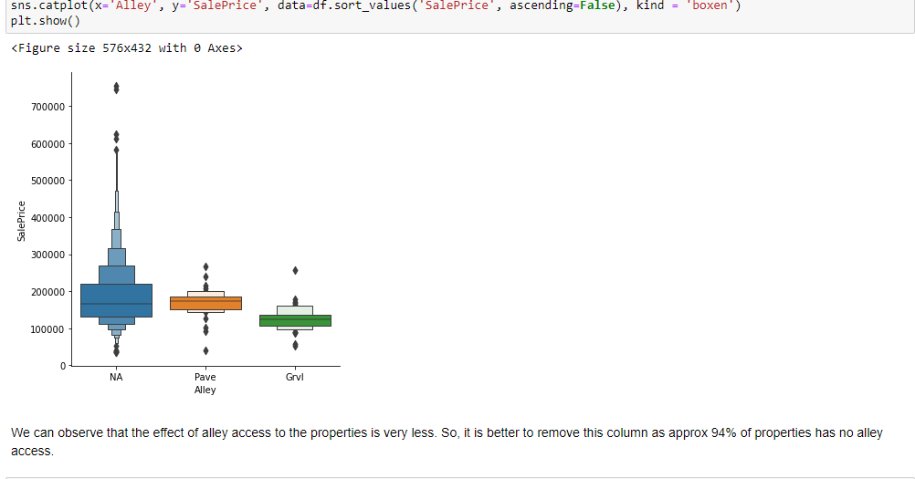

Slide 21
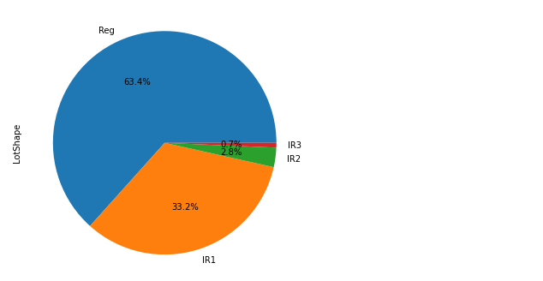

Slide 22
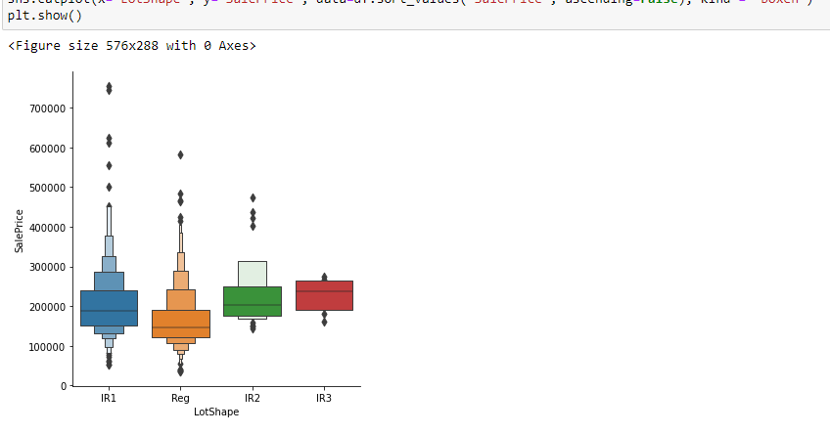

Slide 23
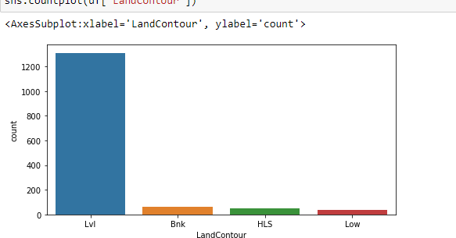

Slide 24
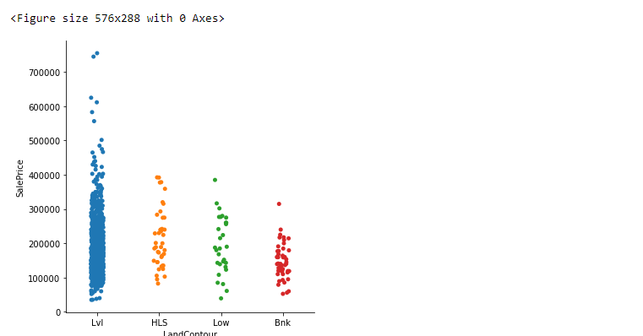

Slide 25
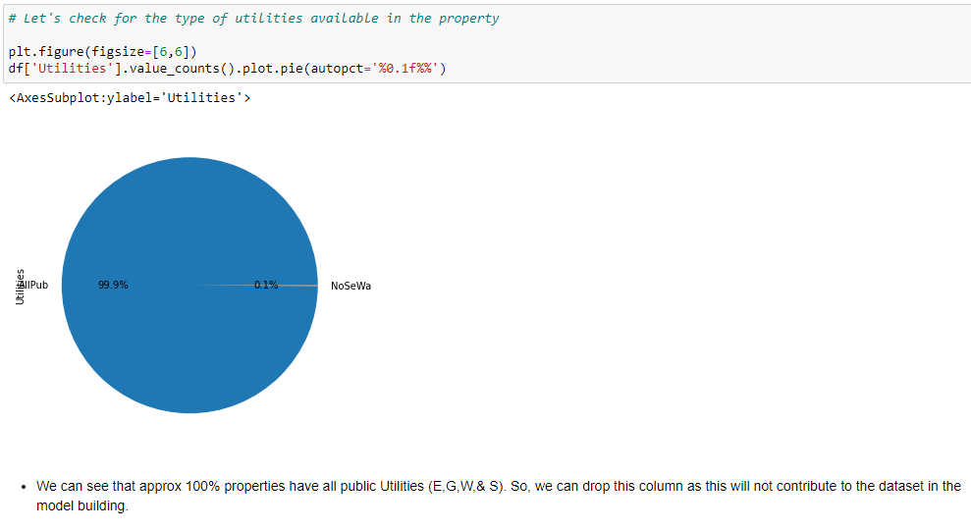

Slide 26
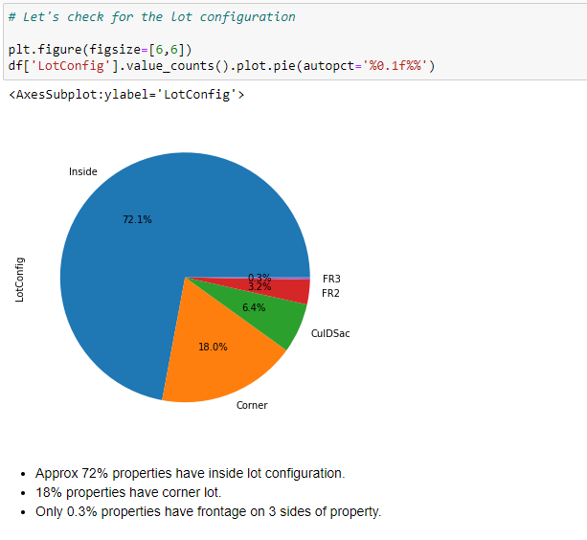

Slide 27
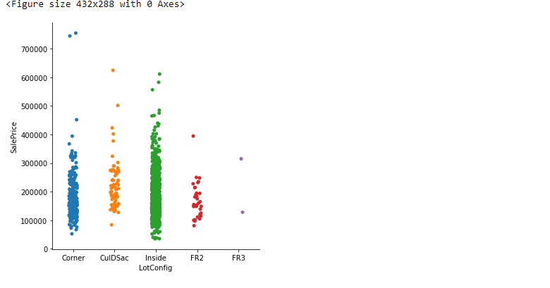

Slide 29
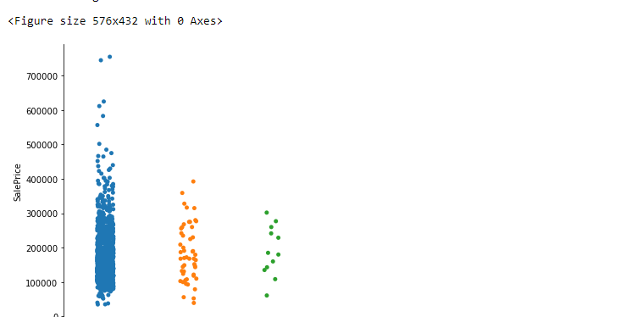

Slide 30
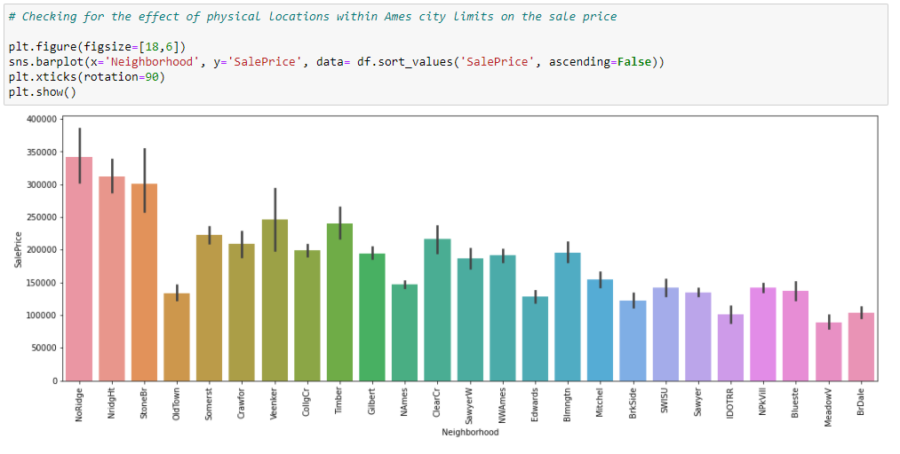

Slide 31
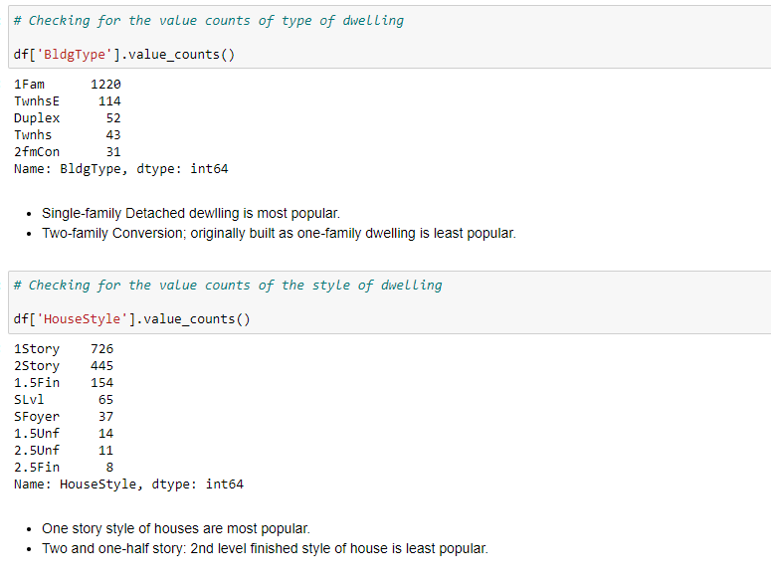

Slide 32
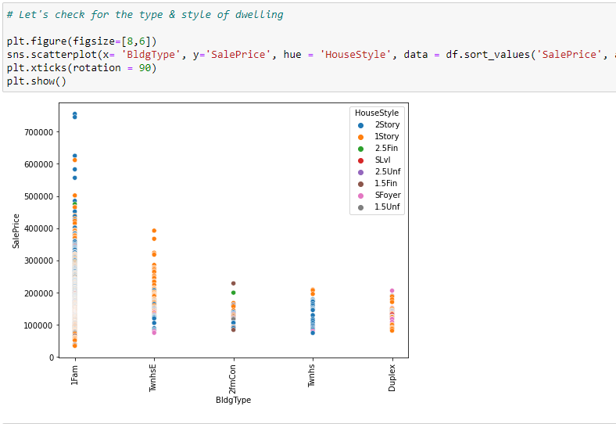

Slide 33
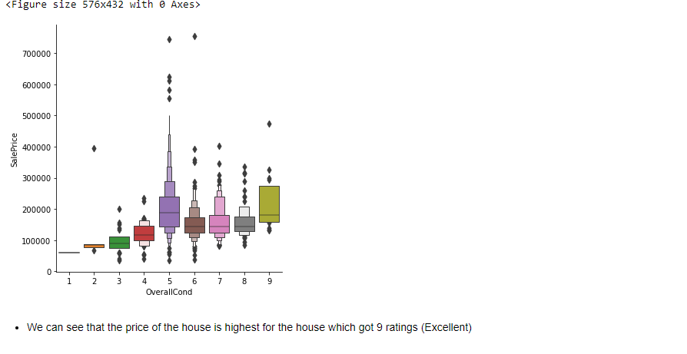

Slide 34
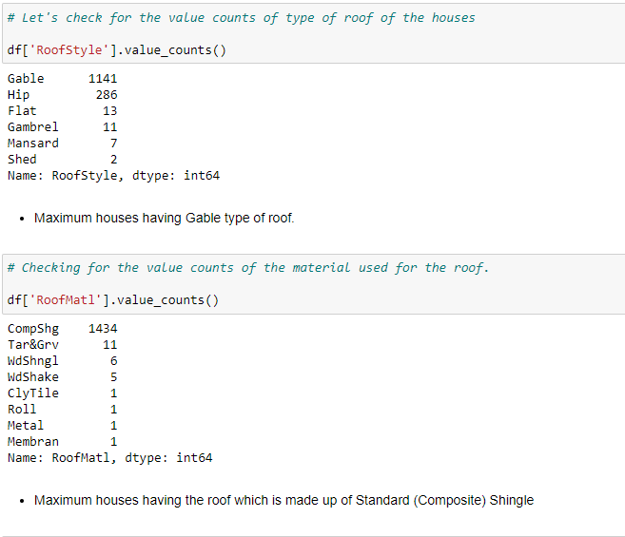

Slide 35
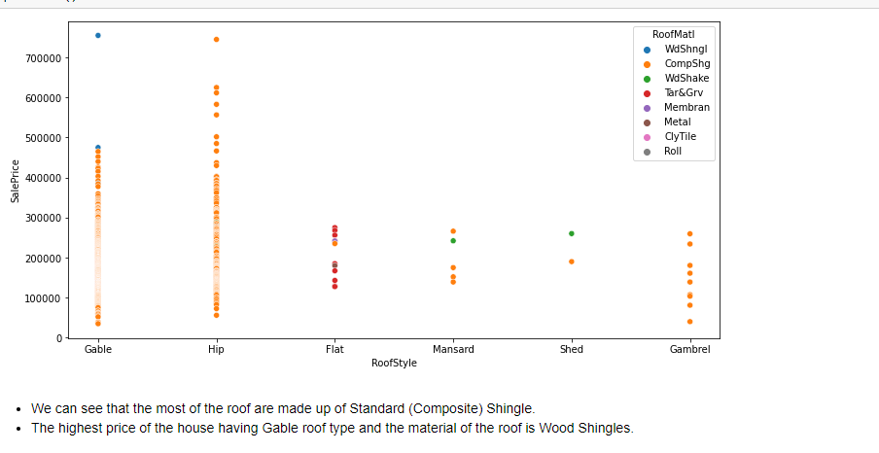

Slide 36
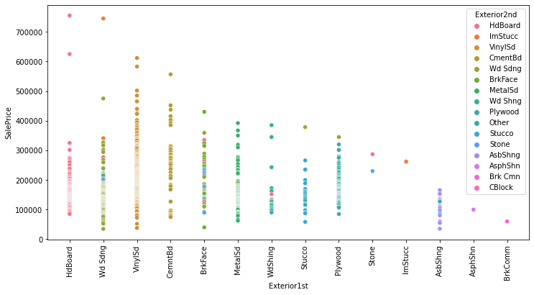

Slide 37
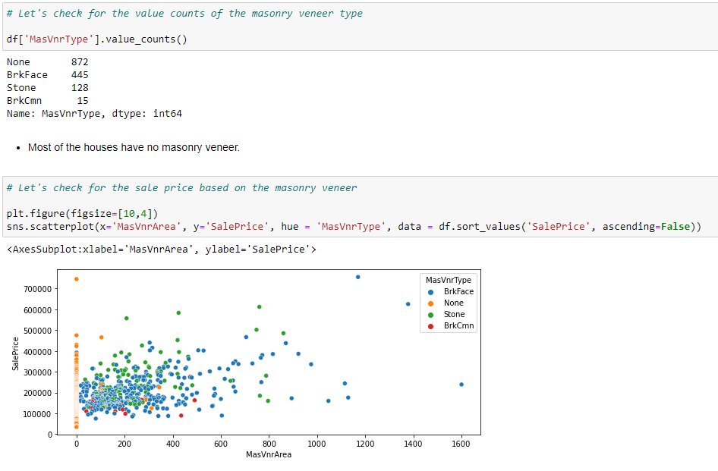

Slide 38
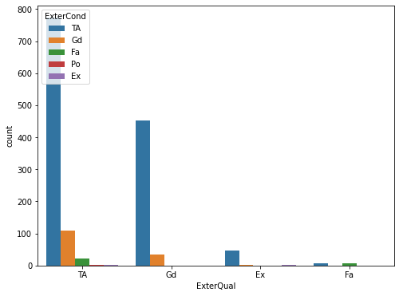
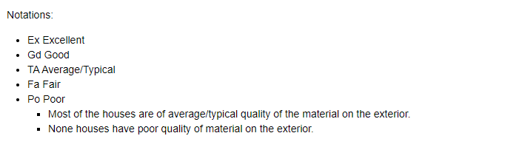

Slide 39
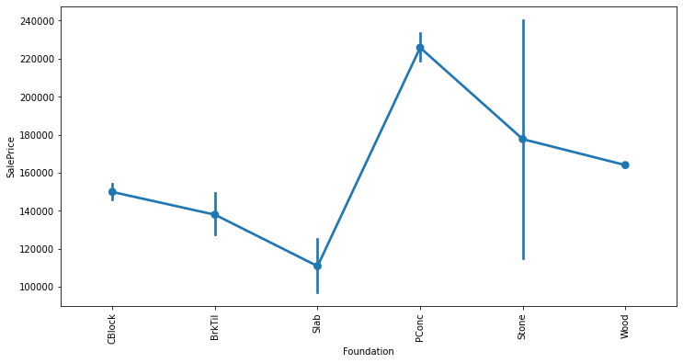

Slide 40

RESULTS AND MODEL BUILDING

Slide 41
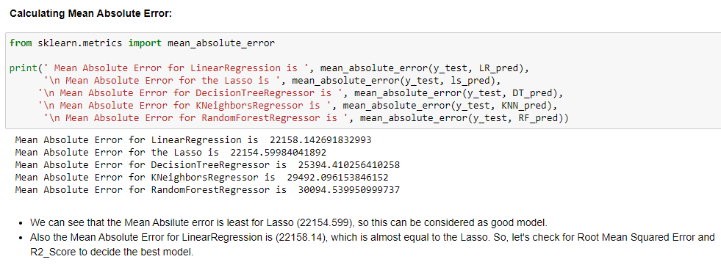
MODEL BUILDING
Below are the algorithms which are used for training and testing the data:
Linear Regression.
Lasso
Decision Tree Regression.
K Neighbours Regression.
Random Forest Regression.

Slide 42
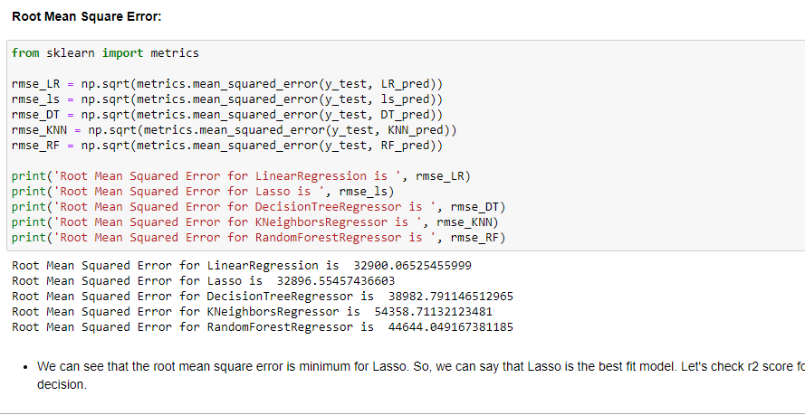

Slide 43
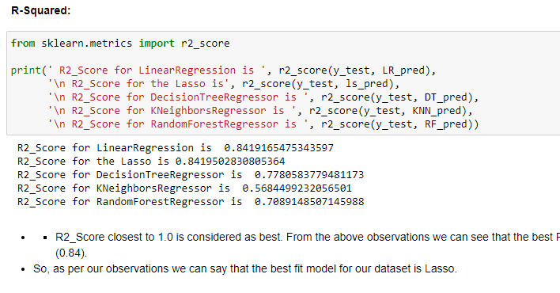

Slide 44

CONCLUSION

Slide 45
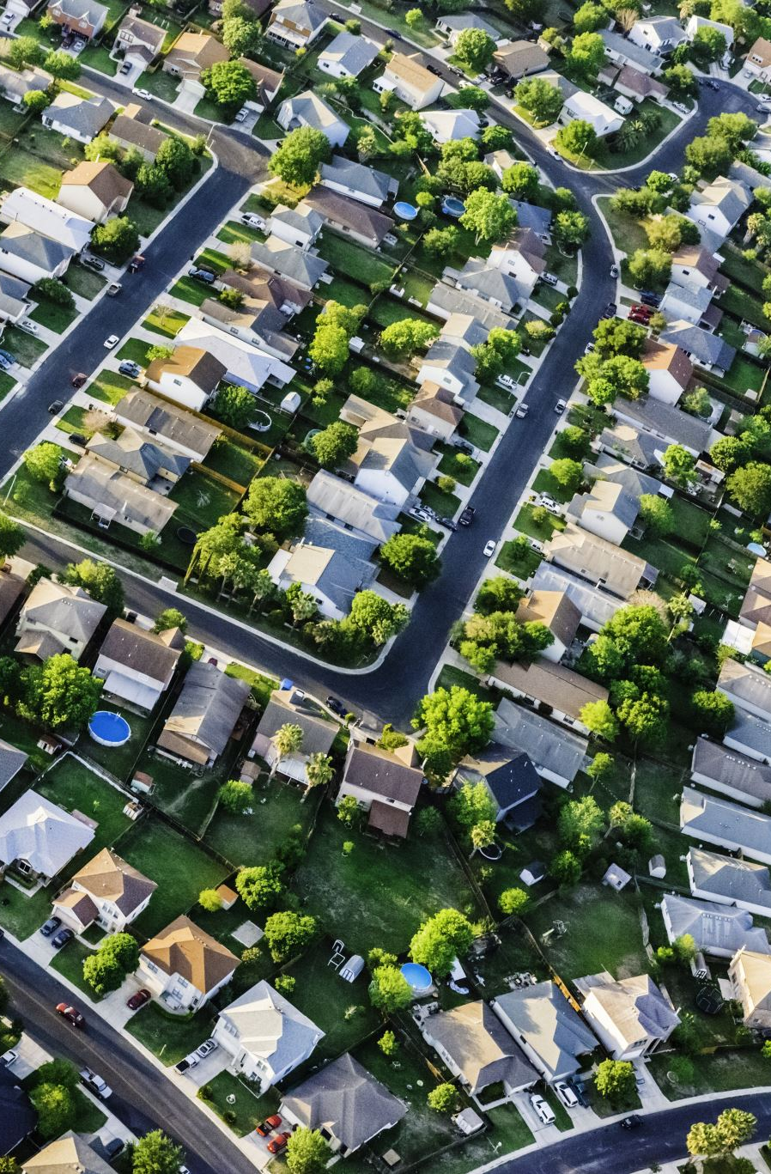
KEY FINDINGS
MS Sub Class seems to have the biggest impact on House Prices, followed by Basement Full Bath and Basement Half Bath.
Other than the Basement related features, Condition 2, Exterior Quality and Lot Area are some of the other important features.

Slide 46
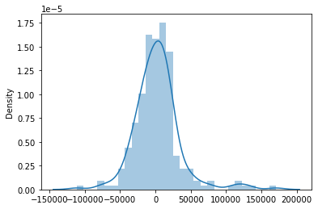
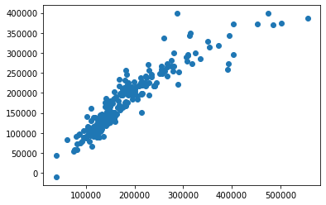

Slide 47

THANK YOU

